Slide 1

TENTATIVE TITLE: ANALYSIS OF CRYPTOGRAPHY ALGORITHM FOR DATA SECURITY ON DATA CLOUD
Supervised By:
Dr. boshir Ahmed
Professor
Department of Cse
Presented By:
md. Shahriar Mahmud
Roll NO: 143113
Department of Cse

Slide 2

Outlines
Previously Described
Objectives.
Motivations
Literature Review
Background Studies
Proposed Methodology
Implementation
Result
Limitation
Conclusion
Future Work
Bibliography

Slide 3

Previously Described
Objectives.
Motivations
Literature Review
Background Studies
Data Server.
Usage
Service and Model
Literature Review
Methodology
Result (Predicted)
Conclusion

Slide 4
Objectives
Add an extra layer of security for sensitive data on Cloud Storage.
Develop a Model for this purpose.
Simulate the Model for getting real-time outcome using Socket Programming (Java).
Compare Efficiency(Storage, Time, Vulnerability) of Algorithms like AES,DES,RSA.
Notes:
https://digitalguardian.com/blog/6-security-risks-enterprises-using-cloud-storage-and-file-sharing-apps
NO CONTROL OVER DATA
DATA LEAKAGE
BYOD
SNOOPING
KEY MANAGEMENT
CLOUD CREDENTIALS

Slide 5
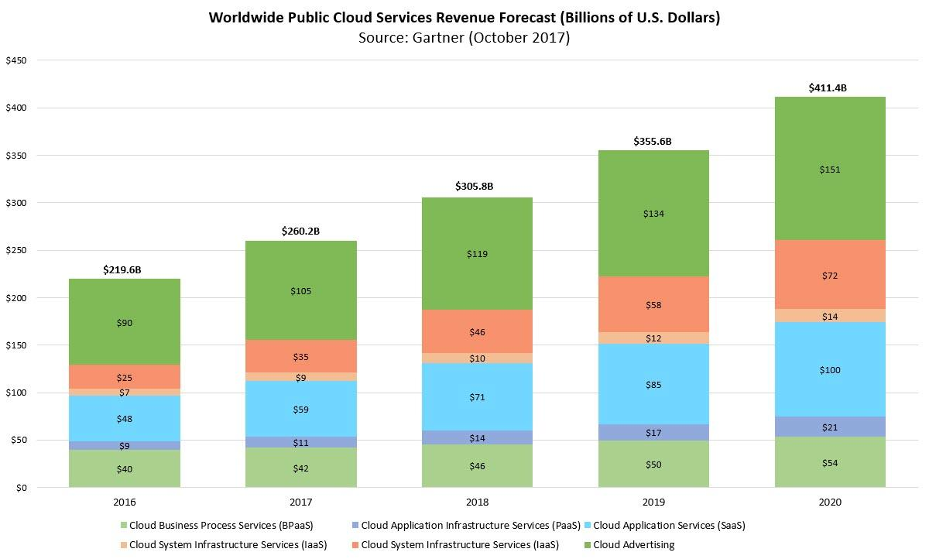
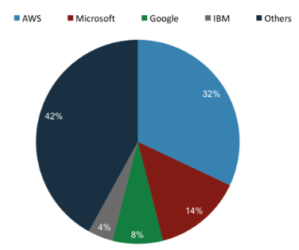
Motivations
Fig: CSP Market Occupied
Fig: Public Cloud Market by Forbes

Slide 6

Motivations(Cont’d)
As of total data of world very poor amount of data are being stored on cloud server because lack of trusted CSP.
Data are often Stolen from Data Server
Data are using for Server purposes (like Data Mining) which also breaches privacy of a Client.
Feeling Unsafe over internet.
Need to trust Cloud Service Provider(CSP).

Slide 7
Literature Review
An Approach towards Data Security in the Cloud Computing Using AES[1]
Describes AES Encryption Algorithm.
Illustrate AES by using CloudSim.
Configure Resistivity against Attacks.
Do not have any Description for other Encryption Algorithm
Do not illustrate any outcome of CloudSIm Simulation.
Secure Data Access in Cloud Computing[4]
Cloud market overview.
Describes D-H key exchange protocol.
Secure data access policy between CSP and User Using D-H key exchange.
Theoretical Implementation of D-H key Exchange .
Whole process is theoretical and algorithm based.
Do not Simulated or Implemented.

Slide 8

Background Study
Security Issues Privacy Preserving and Data Security in Cloud Services[1]
2. Data Security and Privacy protection Issues in Cloud Computing[6]
3. Secure Data Access in Cloud Computing [4]
4. Cryptography Algorithm
5. Cloud Simulation Process using CloudSim [9]
6. Socket Programming in Java

Slide 9


Proposed Methodology
Digital Certification
Decryption
Receiving
Data Server
(Encrypted Data)
Send
Or
Received
Key
Plain Text
CT
Sending
Encryption
Client Side
Fig: Client Server Secure Data Exchange

Slide 10
Result
The result will contain comparison among Encryption Algorithms
Encryption and Decryption time on Authorized Access.
Encryption and Decryption time on Unauthorized Access.
Storage Efficiency.

Slide 11
Result (Cont’d) : AES-128bit 10 Cycle
Data Size (KB) | Encryption Time(ms) | Decryption Time(ms)
0 | 0 | 0
10 | 0 | 0
100 | 1 | 1
200 | 1 | 1
400 | 2 | 1
600 | 2 | 2
700 | 3 | 2
800 | 3 | 2
900 | 3 | 2
1024 | 3 | 2
Table: AES Result on Text Data
Processor: i5-4210U CPU @ 1.70GHz Memory: 8 GB (DDR3) OS: Windows 10

Slide 12





Limitations
Digital Certification
Device 1
No Data
Risk
Single User With Multiple Device
Data Server
No key
Device 2
Fig: Weak Point of Proposed Model
Device 3

Slide 13
Conclusion
Truly 100% security over internet is Rarely Possible
This model allows control over data only by its owner.
In developing solutions to cloud computing security issues it may be helpful to identify the problems and approaches in terms of
Loss of control
Lack of trust
Multi-tenancy problems

Slide 14

Future Work
Compare Efficiency(Storage, Time, Vulnerability ) of Different algorithm(AES,DES,RSA).
Based On:
Simulated Output
Theoretical Output

Slide 15
Bibliography
D. Chen and H. Zhao, “Data Security and Privacy Protection Issues in Cloud Computing,” in 2012 International Conference on Computer Science and Electronics Engineering (ICCSEE), 2012, vol. 1, pp. 647– 651.
Z. Xiao and Y. Xiao, “Security and Privacy in Cloud Computing,” IEEE Communications Surveys Tutorials, vol. 15, no. 2, pp. 843–859, 2013
Santosh Kumar Singh, Dr. P.K. Manjhi, Dr. R.K.Tiwari, ” An Approach towards Data Security in the Cloud Computing Using AES”,in June 2016 International Journal of Advanced Research in Computer and Communication Engineering , Vol. 5, Issue 6, pp. 22-29
Sanka S, Hota C, Rajarajan M (2010) ,”Secure data access in cloud computing”, In: IEEE 4th international conference on Internet multimedia services architecture and application (IMSAA), pp 1–6
Arun Nagraza, N Mangathayaru ; N Rajashekar ,” Privacy preserving and data security — A survey ”in: 2016 International Conference on Engineering & MIS (ICEMIS).
Shaikh Ashapakh Sattar, “ Security Issues in Cloud Services”, in June 2016 International Journal of New Technology and Research Vol.2, Issue-6,pp.08-10.

Slide 16
Bibliography (Cont’d)
Bih-Hwang Lee, Muhammad Farid Wajdi, Ervin Kusuma Dewi; ,” Data security in cloud computing using AES under HEROKU cloud”, 2018 27th Wireless and Optical Communication Conference (WOCC) On: IEEE
Saurabh Kumar Garg and Rajkumar Buyya,”Network CloudSim: Modelling Parallel Applications in Cloud Simulations”, on 2011 Fourth IEEE International Conference on Utility and Cloud Computing, ISSN 978-0-7695-4592-9, pp. 105-113
SuperWits Academy is founded by Anupinder Singh since 2008,” CloudSim Simulation Framework”, https://www.superwits.com/library/cloudsim-simulation-framework.
The NIST Definition of Cloud Computing Recommendations of the National Institute of Standards and Technology.Special Publication 800-145.
Khadijah bahwairteth,Mohammad A,” Experimental comparison of simulation tools for efficient cloud and mobile cloud computing applications” 14 June 2016 by EURASIP Journal on Information Security

Slide 17
THANK YOU
END OF SLIDE

Slide 18
TENTATITIVE TITLE: ANALYSIS OF ENCRYPTION
ALGORITHMS FOR DATA SECURITY ON CLOUD
Supervised By:
Dr. boshir Ahmed
Professor
Department of Cse
Presented By:
md. Shahriar Mahmud
Roll NO: 143113
Department of Cse

Slide 19
Outlines
Objectives.
Motivations
Cloud.
Usage
Service and Model
Literature Review
Background Studies
Methodology
Implementation
CloudSim Architecture
Result
Conclusion
Future Work
Bibliography

Slide 20
OBJECTIVES
Secure Cloud Computation against threads.
Comparative analysis of Encryption algorithm in cloud computing.
Simulate for getting real-time outcome using CloudSim.

Slide 21
Motivations
Fig: CSP Market Occupied
Fig: Public Cloud Market by Forbes

Slide 22

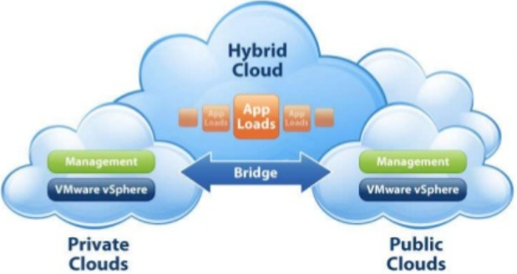
Motivations(Cont’d)
Benefits of Cloud Computing[2]
Cloud Services[10]

Slide 23
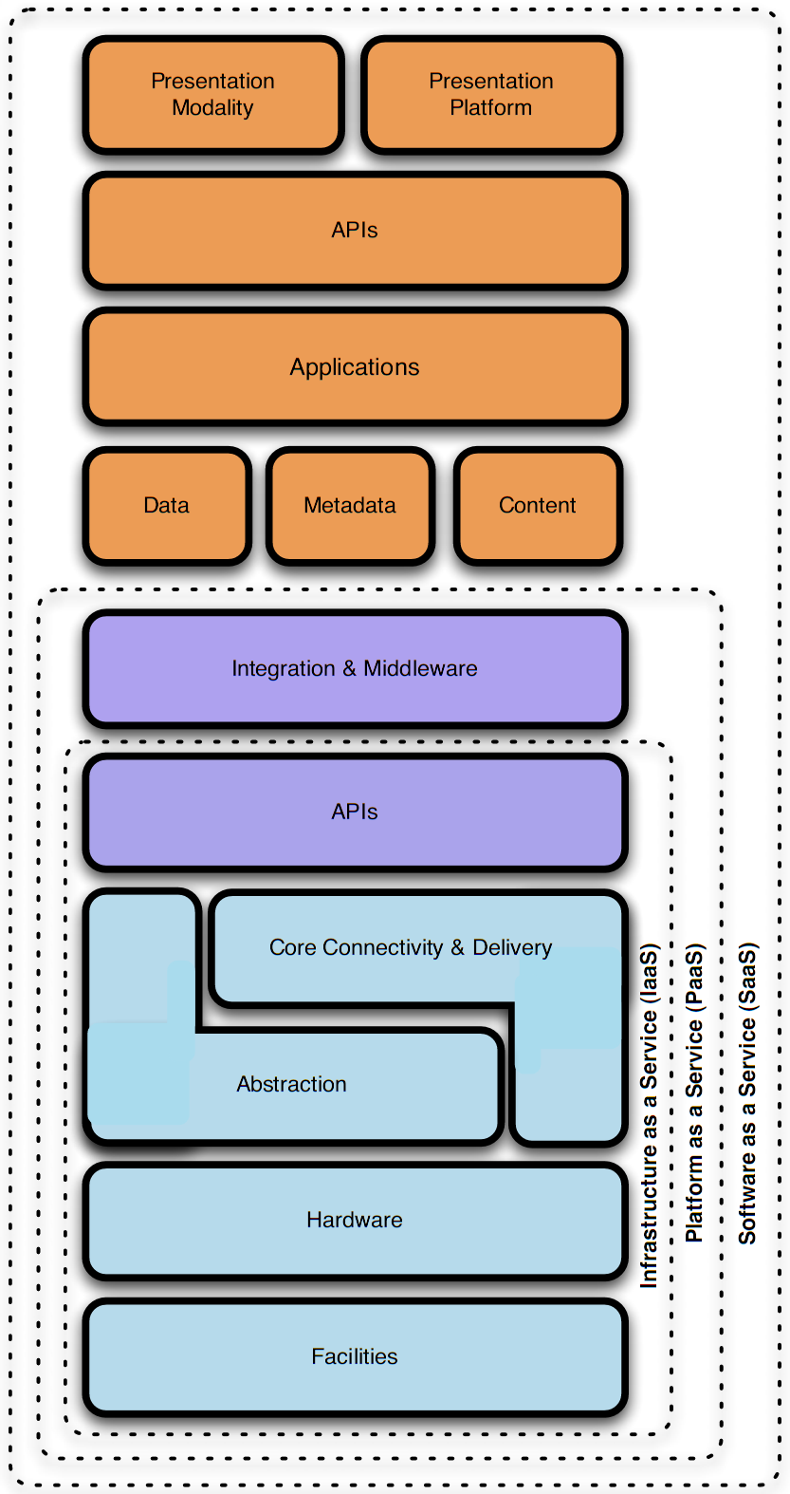
Cloud Service Models
‘X’ aaS[1]
Notes:
CSA, Security guidance for critical areas of focus in cloud computing
There are so many different cloud deployment options. This is a popular service model. It is called SPI service models.
SPI refers to Software as a Service, Platform as a Service, or Infrastructure as a Service, explained in depth in next slides
Higher layers are built on lower layers. Higher abstractions include lower ones.

Slide 24
Literature Review
An Approach towards Data Security in the Cloud Computing Using AES[1]
Describes AES Encryption Algorithm.
Illustrate AES by using CloudSim.
Configure Resistivity against Attacks.
Do not have any Description for other Encryption Algorithm
Do not illustrate any outcome of CloudSIm Simulation.
Secure Data Access in Cloud Computing[4]
Cloud market overview.
Describes D-H key exchange protocol.
Secure data access policy between CSP and User Using D-H key exchange.
Theoretical Implementation of D-H key Exchange .
Whole process is theoretical and algorithm based.
Do not Simulated or Implemented.

Slide 25
Background Study
Security Issues Privacy Preserving and Data Security in Cloud Services[1]
2. Data Security and Privacy protection Issues in Cloud Computing[6]
3. Secure Data Access in Cloud Computing [4]
4. Cryptography Algorithm
5. Cloud Simulation Process using CloudSim [9]

Slide 26
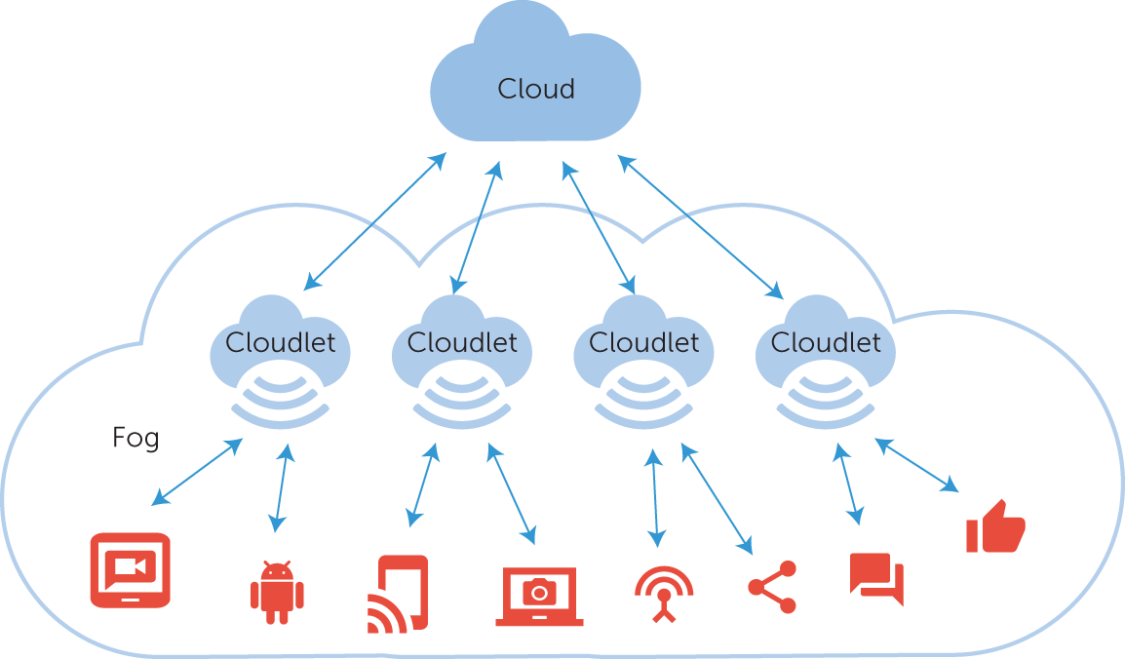
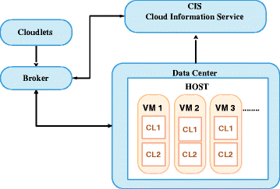
Methodology
Fig: Client to Cloud[11]
Fig: Cloud Internal Architecture[11]

Slide 27
Implementation
Algorithms DES,AES,D-H key Exchange etc.
Support for modelling and simulation of large scale Cloud Computing resources.
Platform for modeling data Contents, service brokers, Scheduling and Load Balancing Policies
Implementation Tool
Eclipse
CloudSim Toolkit
UML design Tool
Flexibility to switch between space shared and time-shared allocation
Support for simulation of network corrections.
Fig: CloudSim[3]

Slide 28
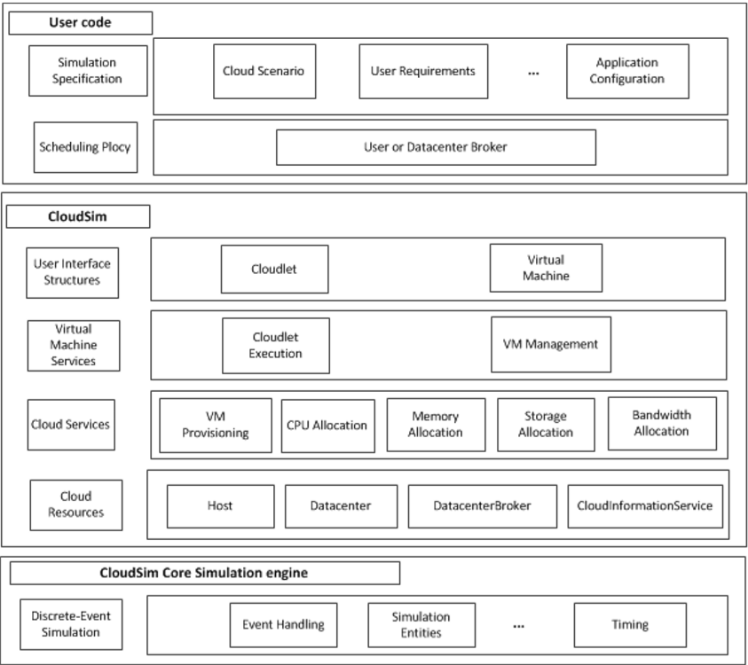
The CloudSim Architecture[3]

Slide 29
Result
The result will contain comparison among Encryption Algorithms
Encryption and Decryption time on Authorized Access.
Encryption and Decryption time on Unauthorized Access.
Storage Efficiency.
Etc.

Slide 30
Conclusion
Cloud computing is sometimes viewed as a reincarnation of the classic mainframe client-server model
However, resources are ubiquitous, scalable, highly virtualized
Contains all the traditional threats, as well as new ones
In developing solutions to cloud computing security issues it may be helpful to identify the problems and approaches in terms of
Loss of control
Lack of trust
Multi-tenancy problems

Slide 31
Future Work
1. Implement security Algorithm on cloud simulator.
2. Simulate on CloudSim.
3. Get a comparative result among algorithms.

Slide 32
BIBLIOGRAPHY
D. Chen and H. Zhao, “Data Security and Privacy Protection Issues in Cloud Computing,” in 2012 International Conference on Computer Science and Electronics Engineering (ICCSEE), 2012, vol. 1, pp. 647– 651.
Z. Xiao and Y. Xiao, “Security and Privacy in Cloud Computing,” IEEE Communications Surveys Tutorials, vol. 15, no. 2, pp. 843–859, 2013
Santosh Kumar Singh, Dr. P.K. Manjhi, Dr. R.K.Tiwari, ” An Approach towards Data Security in the Cloud Computing Using AES”,in June 2016 International Journal of Advanced Research in Computer and Communication Engineering , Vol. 5, Issue 6, pp. 22-29
Sanka S, Hota C, Rajarajan M (2010) ,”Secure data access in cloud computing”, In: IEEE 4th international conference on Internet multimedia services architecture and application (IMSAA), pp 1–6
Arun Nagraza, N Mangathayaru ; N Rajashekar ,” Privacy preserving and data security — A survey ”in: 2016 International Conference on Engineering & MIS (ICEMIS).
Shaikh Ashapakh Sattar, “ Security Issues in Cloud Services”, in June 2016 International Journal of New Technology and Research Vol.2, Issue-6,pp.08-10.

Slide 33
BIBLIOGRAPHY (Cont’d)
Bih-Hwang Lee, Muhammad Farid Wajdi, Ervin Kusuma Dewi; ,” Data security in cloud computing using AES under HEROKU cloud”, 2018 27th Wireless and Optical Communication Conference (WOCC) On: IEEE
Saurabh Kumar Garg and Rajkumar Buyya,”Network CloudSim: Modelling Parallel Applications in Cloud Simulations”, on 2011 Fourth IEEE International Conference on Utility and Cloud Computing, ISSN 978-0-7695-4592-9, pp. 105-113
SuperWits Academy is founded by Anupinder Singh since 2008,” CloudSim Simulation Framework”, https://www.superwits.com/library/cloudsim-simulation-framework.
The NIST Definition of Cloud Computing Recommendations of the National Institute of Standards and Technology.Special Publication 800-145.
Khadijah bahwairteth,Mohammad A,” Experimental comparison of simulation tools for efficient cloud and mobile cloud computing applications” 14 June 2016 by EURASIP Journal on Information Security

Slide 34
THANK YOU
END OF SLIDE

